Slide 1
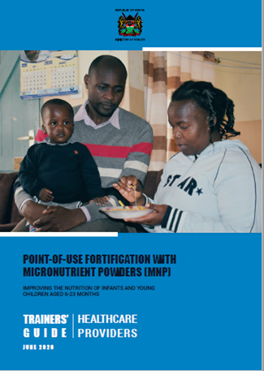
Point-of-use fortification with micronutrient powders for children aged 6-23 months

Slide 2
Outline
Background
Current Micronutrient Situation
Under five Micronutrient Deficiencies (KNMS 2011)
Why point-of-use fortification?
Supportive policy environment and Legal framework
Home fortification Policy information
Approaches used to Address Micronutrient Deficiencies
Achievements and progress

Slide 3
Background
Global evidence has shown that point-of-use fortification of foods with MNPs is an effective intervention to reduce anaemia and ID in children 6-23 mos (De-Regil L et al, 2011)
In developing countries every second pregnant woman and about 40% of preschool children are estimated to be anaemic (WHO, 2012)
Malnutrition in all its forms threatens the achievement of the Sustainable Development Goals by 2030 (WHO 2019)
Malnutrition increases the risk of morbidity and mortality contributing to close to half of all deaths in children under five years

Slide 4
Background cont’d
WHO's mandate is to assess the micronutrient status of populations, monitor and evaluate the impact of strategies for the prevention and control of micronutrient malnutrition, and to track related trends over time (https://www.who.int/vmnis/en/2020)
The Vitamin and Mineral Nutrition Information System (VMNIS), was established in 1991 following a request by the World Health Assembly to strengthen surveillance of micronutrient deficiencies at the global level

Slide 5
Background Cont’d
Systematically retrieve and summarize data on vitamin and mineral status of populations
Provide Member States with up-to-date national, regional, and global assessments of the magnitude of vitamin and mineral deficiencies
Track progress towards the goal of eliminating major vitamin and mineral deficiencies
Provide tools and resources to support efforts of Member States and their partners for assessing vitamin and mineral nutritional status in populations

Slide 6
Current micronutrient situation
Micronutrient deficiency is widespread in the industrialized nations, but even more so in developing countries
It affects all age groups, with the vulnerable groups being at higher risk of developing micronutrient deficiencies
Micronutrient deficiency has many adverse effects on human health
Direct health effects e.g. rickets, anemia
Implications on economic development and productivity particularly in terms of the potentially huge public health costs and the loss of human capital formation
Notes:
(WHO, 2006).
Micronutrient deficiencies; anaemia, night blindness, low immune development, mental growth.
iron deficiency exacts its heaviest overall toll in terms of ill-health, premature death and lost earnings.

Slide 7
Micronutrient Status in Kenya
Kenya experiencing triple burden of malnutrition; undernutrition(stunting, underweight and wasting), over nutrition and micronutrient deficiency
41% had an adequately diverse diet ( KDHS, 2014)
Only 22% of the children 6-23 months old received the Minimum Acceptable Diet
33% of children age 6-23 months consumed foods rich in iron the day or night preceding the survey

Slide 8
Micronutrient Status Cont’d
The most common MDs include vitamin A deficiency (VAD), iron deficiency anaemia (IDA), iodine deficiency and zinc deficiency
Together, these affect at least one third of the world’s population, the majority of whom are in developing countries
Iron deficiency is the most prevalent. It is estimated that just over 2 billion people are anaemic
Just under 2 billion have inadequate iodine nutrition
254 million preschool-aged children are vitamin A deficient (WHO, 2012)
Notes:
Fe & essential MNDs drains the life and vitality out of development.

Slide 9
Status Cont’d
Out of all children 6-59 months, 83.3% had
low plasma zinc, which is an indication of zinc
deficiency among pre-school children
1 out of every 4 (26.3%) suffers from anemia
Vitamin A Deficiency (VAD) affects 1 out of every 10 (9.2%) children
1 out of every 2 (52.6%) children are at risk of VAD (Marginal)
Zinc deficiency affects 8 out of every 10 (81.6%) children
Anaemia prevalence of 20% or higher for 6–23months give MNPs

Slide 10
Under five Micronutrient Deficiencies (KNMS 2011)
Vitamin A deficiency (under five) : 9.2 %
Iron Deficiency (under five) : 73 %
Zinc Deficiency (under five) : 51 %
Iron Deficiency Anemia (women): 55%

Slide 11
Why point-of –use fortification?
High Prevalence of
Micronutrient Deficiencies
–
Major Direct Cause:
Inadequate micronutrient intake

Slide 12
Reasons for low micronutrient intake
Low dietary diversity
(Affordability & availability)
Complementary foods (too low nutrient-content, and -density; too early introduction)
(watery porridges, foods with limited nutrient-content)
Inadequate micronutrient status of pregnant & lactating women
(inadequate intake for the child)
Poor bioavailability of micronutrients
(absorption inhibitors, especially in plant-source based diet)

Slide 13
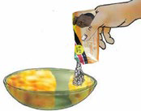
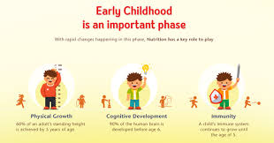
Importance and rationale of fortification
Strategy to improve the nutrient content of foods by compensating for lack of dietary diversity
MNPs are also essential for increasing immunity, physical growth strength
promoting good cognitive development and Productivity

Slide 14
Rationale Cont’d
Micronutrient Powder (MNP) are sachets with dry powder of 15 micronutrients that can be added to any semi-solid food ready for consumption
Improves the nutritional quality of the diet when added immediately before consumption
Can also occur outside the home; such as schools or child care facilities

Slide 15
Supportive policy environment and Legal framework
World Health Organization (WHO) guidelines on point-of-use fortification with MNPs
The Constitution of Kenya, 2010 (Articles 43 & 53)
The Kenya Nutrition Action Plan (KNAP), 2018-2022
National Social Marketing and communication strategy for food fortification (2015)
National Policy Guideline on Home Fortification with MNP for Children 6-23 Months in Kenya, 2013
Operational Guidelines for Health Workers in Kenya: Home Fortification with Multiple Micronutrient Powders, 2016
National Baby Friendly Community Initiative (BFCI) Trainers’ Guide, 2018
National MIYCN Policy Guidelines (Draft, 2020)

Slide 17
Approaches used to Address Micronutrient Deficiencies
Dietary diversification- consuming varied food groups for necessary micronutrients in adequate amounts & Bio-fortification - improvement of nutritional quality of food crops during production
Supplementation – taking vitamins and minerals in different forms
Mass fortification - addition of micronutrients to commonly consumed foods
Public Health Measures- improved sanitation,
malaria control and treatment, routine deworming,
education & counseling

Slide 18
Summary achievements
The Ministry of Health commitment to address the triple burden of malnutrition as outlined in the KHP (2014-2030) and National Food and Nutrition Security Policy, 2012
Developed Point-of-use fortification with Micronutrient Powder Manuals to guide HCP & CHVs
MNPs now in the KEML, June, 2019 passed and included in the WHO guideline
KHIS-Aggregate captures MNPs as one of the important nutrition indicators

Slide 19
Cont’d achievements
Kenya signing up to “Scaling Up Nutrition” (SUN) in November 2012, demonstrating the Government’s commitment in eradicating hunger and malnutrition
The Government is also committed to ensuring equitable access to and uptake of High Impact Nutrition Interventions (HINI), stipulated in the National Food and Nutrition Security Policy gazetted in 2012
KNAP 2018-22 launch and adaption by counties in via CNAPs

Slide 20
Expected progress
Country wide capacity building of frontline Health Care Providers
Improved micronutrient status and reduced vitamin and mineral deficiencies -achieving Kenya’s Vision 2030 and the Sustainable Development Goals
Integration of nutrition interventions into national UHC plans; and to progressively expand the list of available nutrition actions as more resources become available
Notes:
We have both the means and potential to achieve widespread improvement

Slide 21
Content of Manuals
Session 1: Course Introduction
Session 2: Background on Micronutrient Deficiencies
Session 3: Role of Point-of-Use Fortification With MNPs in Infant and Young Child Nutrition
Session 4: Point-of-Use Fortification with MNPs
Session 5: Commodity Management and Reporting on MNPs
Session 6: Role of Social and Behaviour Change Communication in Improving the Uptake of MNPs
Session 7: Action Planning

Slide 22
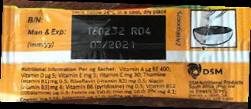
MNP Sachet

Slide 23
Composition in 1gm sachet
Vitamin A 400 μg RE
Vitamin D 5 μg
Vitamin E 5 mg
Vitamin C 30 mg
Vitamin B1 (Thiamine) 0.5 mg
Vitamin B2 (Riboflavin) 0.5 mg
Vitamin B3 (Niacin) 6 mg
Vitamin B6 (Pyridoxine) 0.5 mg
Vitamin B12 (Cobalamin) 0.9 μg
Folate 150 μg
Iron 10 mg
Zinc 4.1 mg
Copper 0.56 mg
Selenium 17 μg
Iodine 90 μg

Slide 27
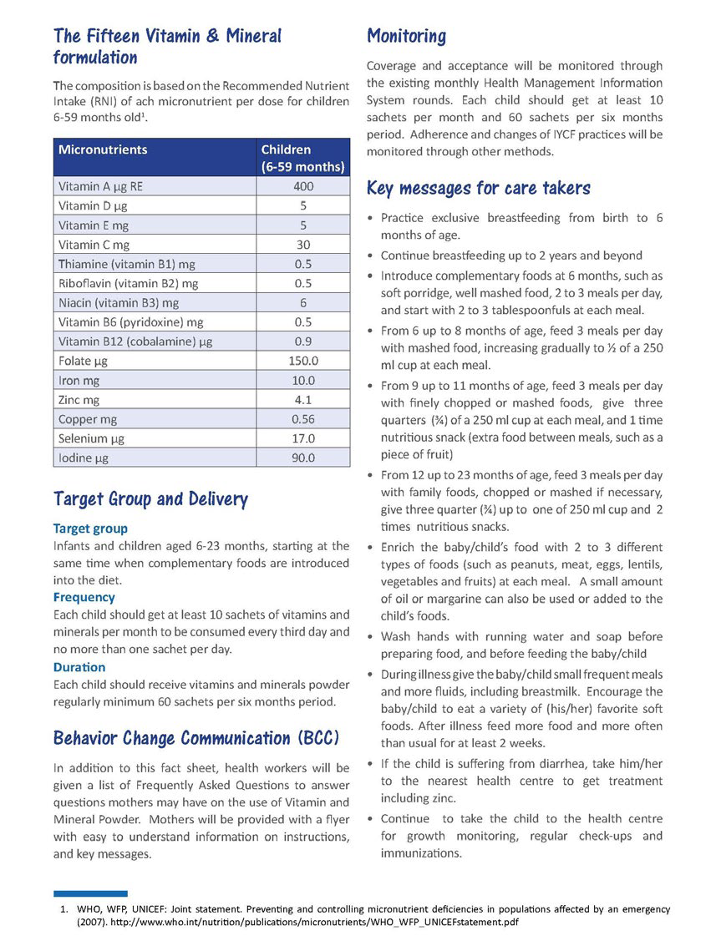
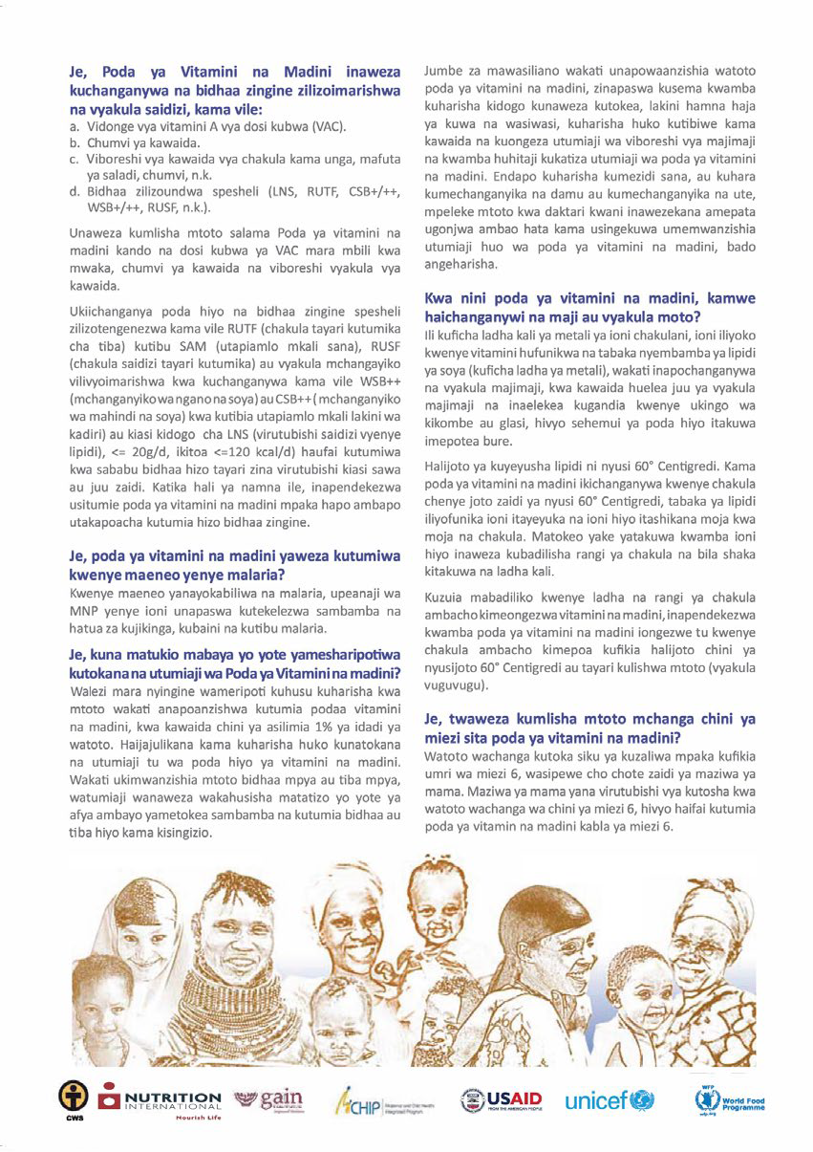

Slide 28
COMBAT HIDDEN HUNGER
FOR
A HEALTHY AND PRODUCTIVE NATION

